Slide 1

What Is the Metaverse, Exactly?
2024052015 Kim DongGoen / 2024088304 Kim YeRim / 2024021030 Kang SeonWoo
2024025087 Seong Seoyeon / 2024075350 Khegay Viktoriya

Slide 2


Background Knowledge for Understanding the Metaverse
Meta
Roblox
Most companies

Slide 3
Meta
Cyber space
The meaning doesn’t change significantly
The ‘metaverse’ does not actually refer to a specific type of technology

Slide 4
They describe the metaverse as a virtual world and augmented reality, but it’s not limited to just those aspects
Most Companies
A new digital economy concept where users can create, buy, and sell goods
some advocates
They claim new technologies like NFTs can enable portable digital assets

Slide 5



Is that really what “the metaverse” means?
Just some new kinds of video games?
A persistent virtual world where players can buy and sell goods
virtual experiences like concerts

Slide 6
Companies building technologies that allow interaction with virtual worlds
Large corporations
Microsoft , Meta
Relatively smaller companies
Nvidia , Unity, Roblox

Slide 7
The idea of Ready Player One-like single unified place called “the metaverse” is still largely impossible
Low profitability
insufficient
computing technology
lack of necessity for collaboration

Slide 8
The emergence of new terminology
multiverse of metaverses.
hybrid-verse.
By this definition, anything from a VR concert app to a video game would count as a “metaverse.”

Slide 9
The emergence of new terminology
It's at this point that most discussions about what the metaverse entails start to stall.
multiverse of metaverses.
hybrid-verse.
By this definition, anything from a VR concert app to a video game would count as a “metaverse.”

Slide 10


we could kind of call the metaverse
if we massage the definition of words the right way
Meta
Microsoft
Apple

Slide 11
What's the Metaverse Like Right Now?
The paradox of defining the metaverse is that in order for it to be the future, you have to define away the present.
The definition of the metaverse is still inaccurate
Metaverse : An evolution of the simple internet

Slide 12
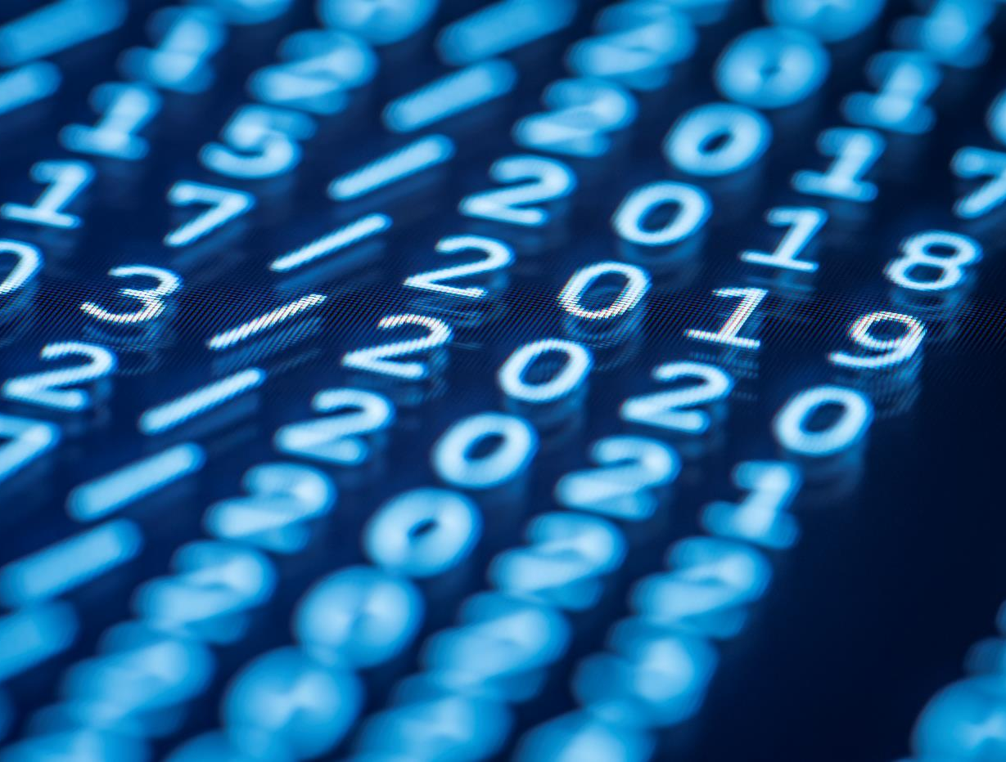
Thanks for Listening

